Slide 1

Department of Electrical and Computer Engineering
Application Exploration of 5G-and-Beyond Wireless Systems and Rural Broadband
Client: Dr Hongwei Zhang
Team Name: SDDEC23-12
Website: https://sddec23-12.sd.ece.iastate.edu/

Slide 2
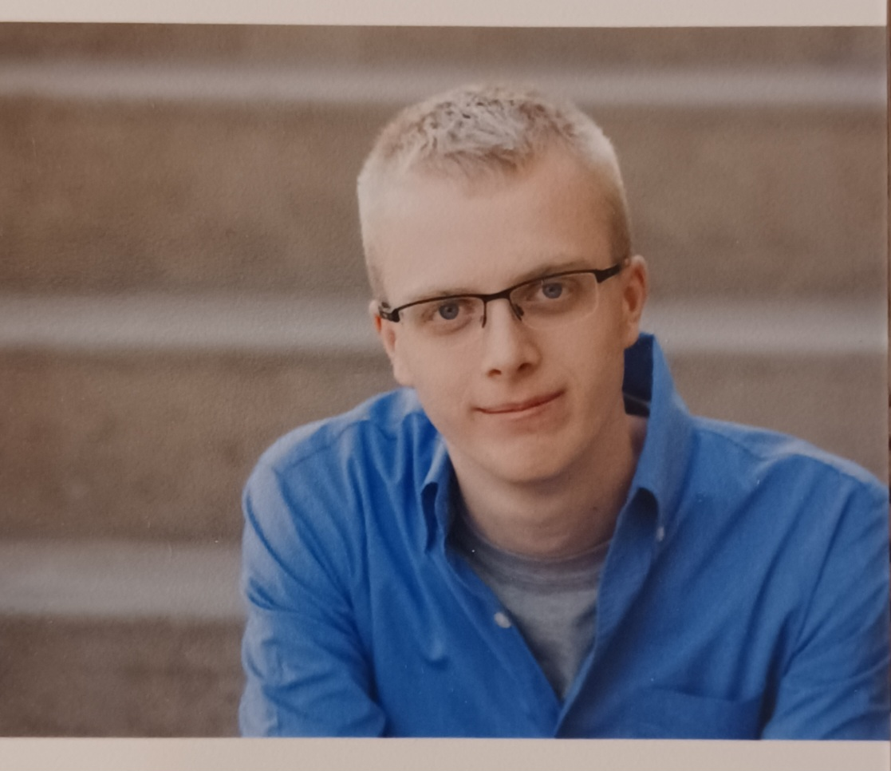
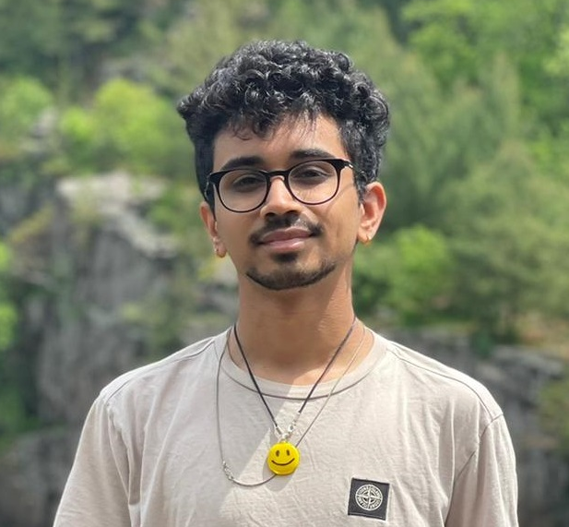
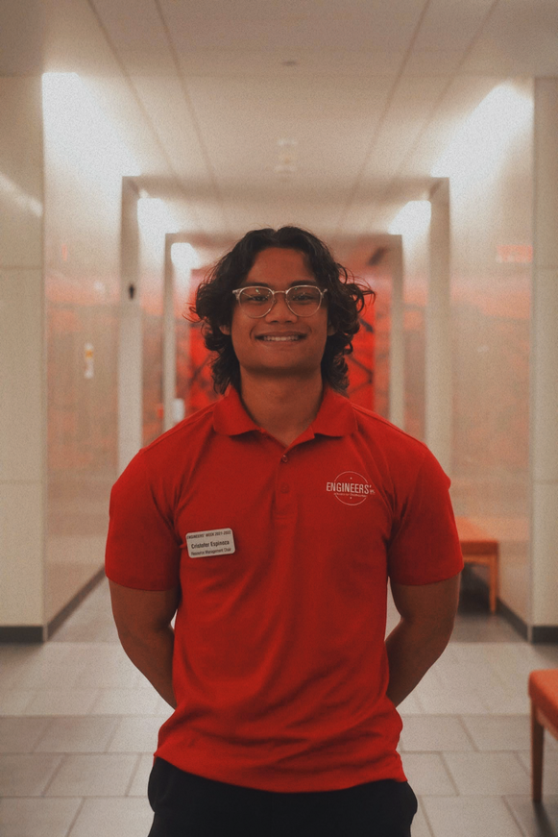
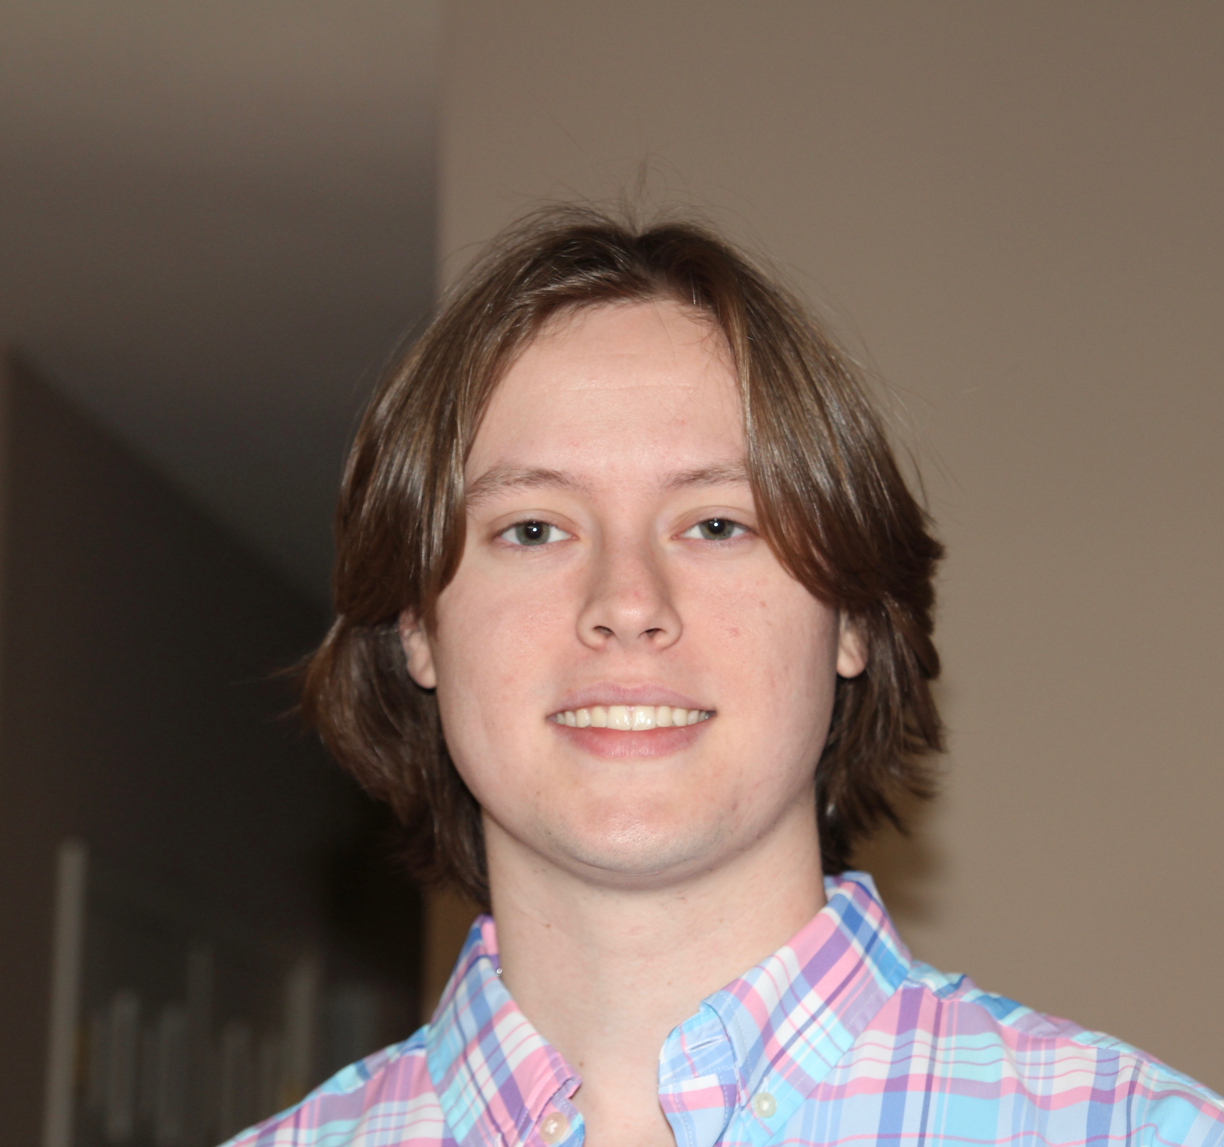

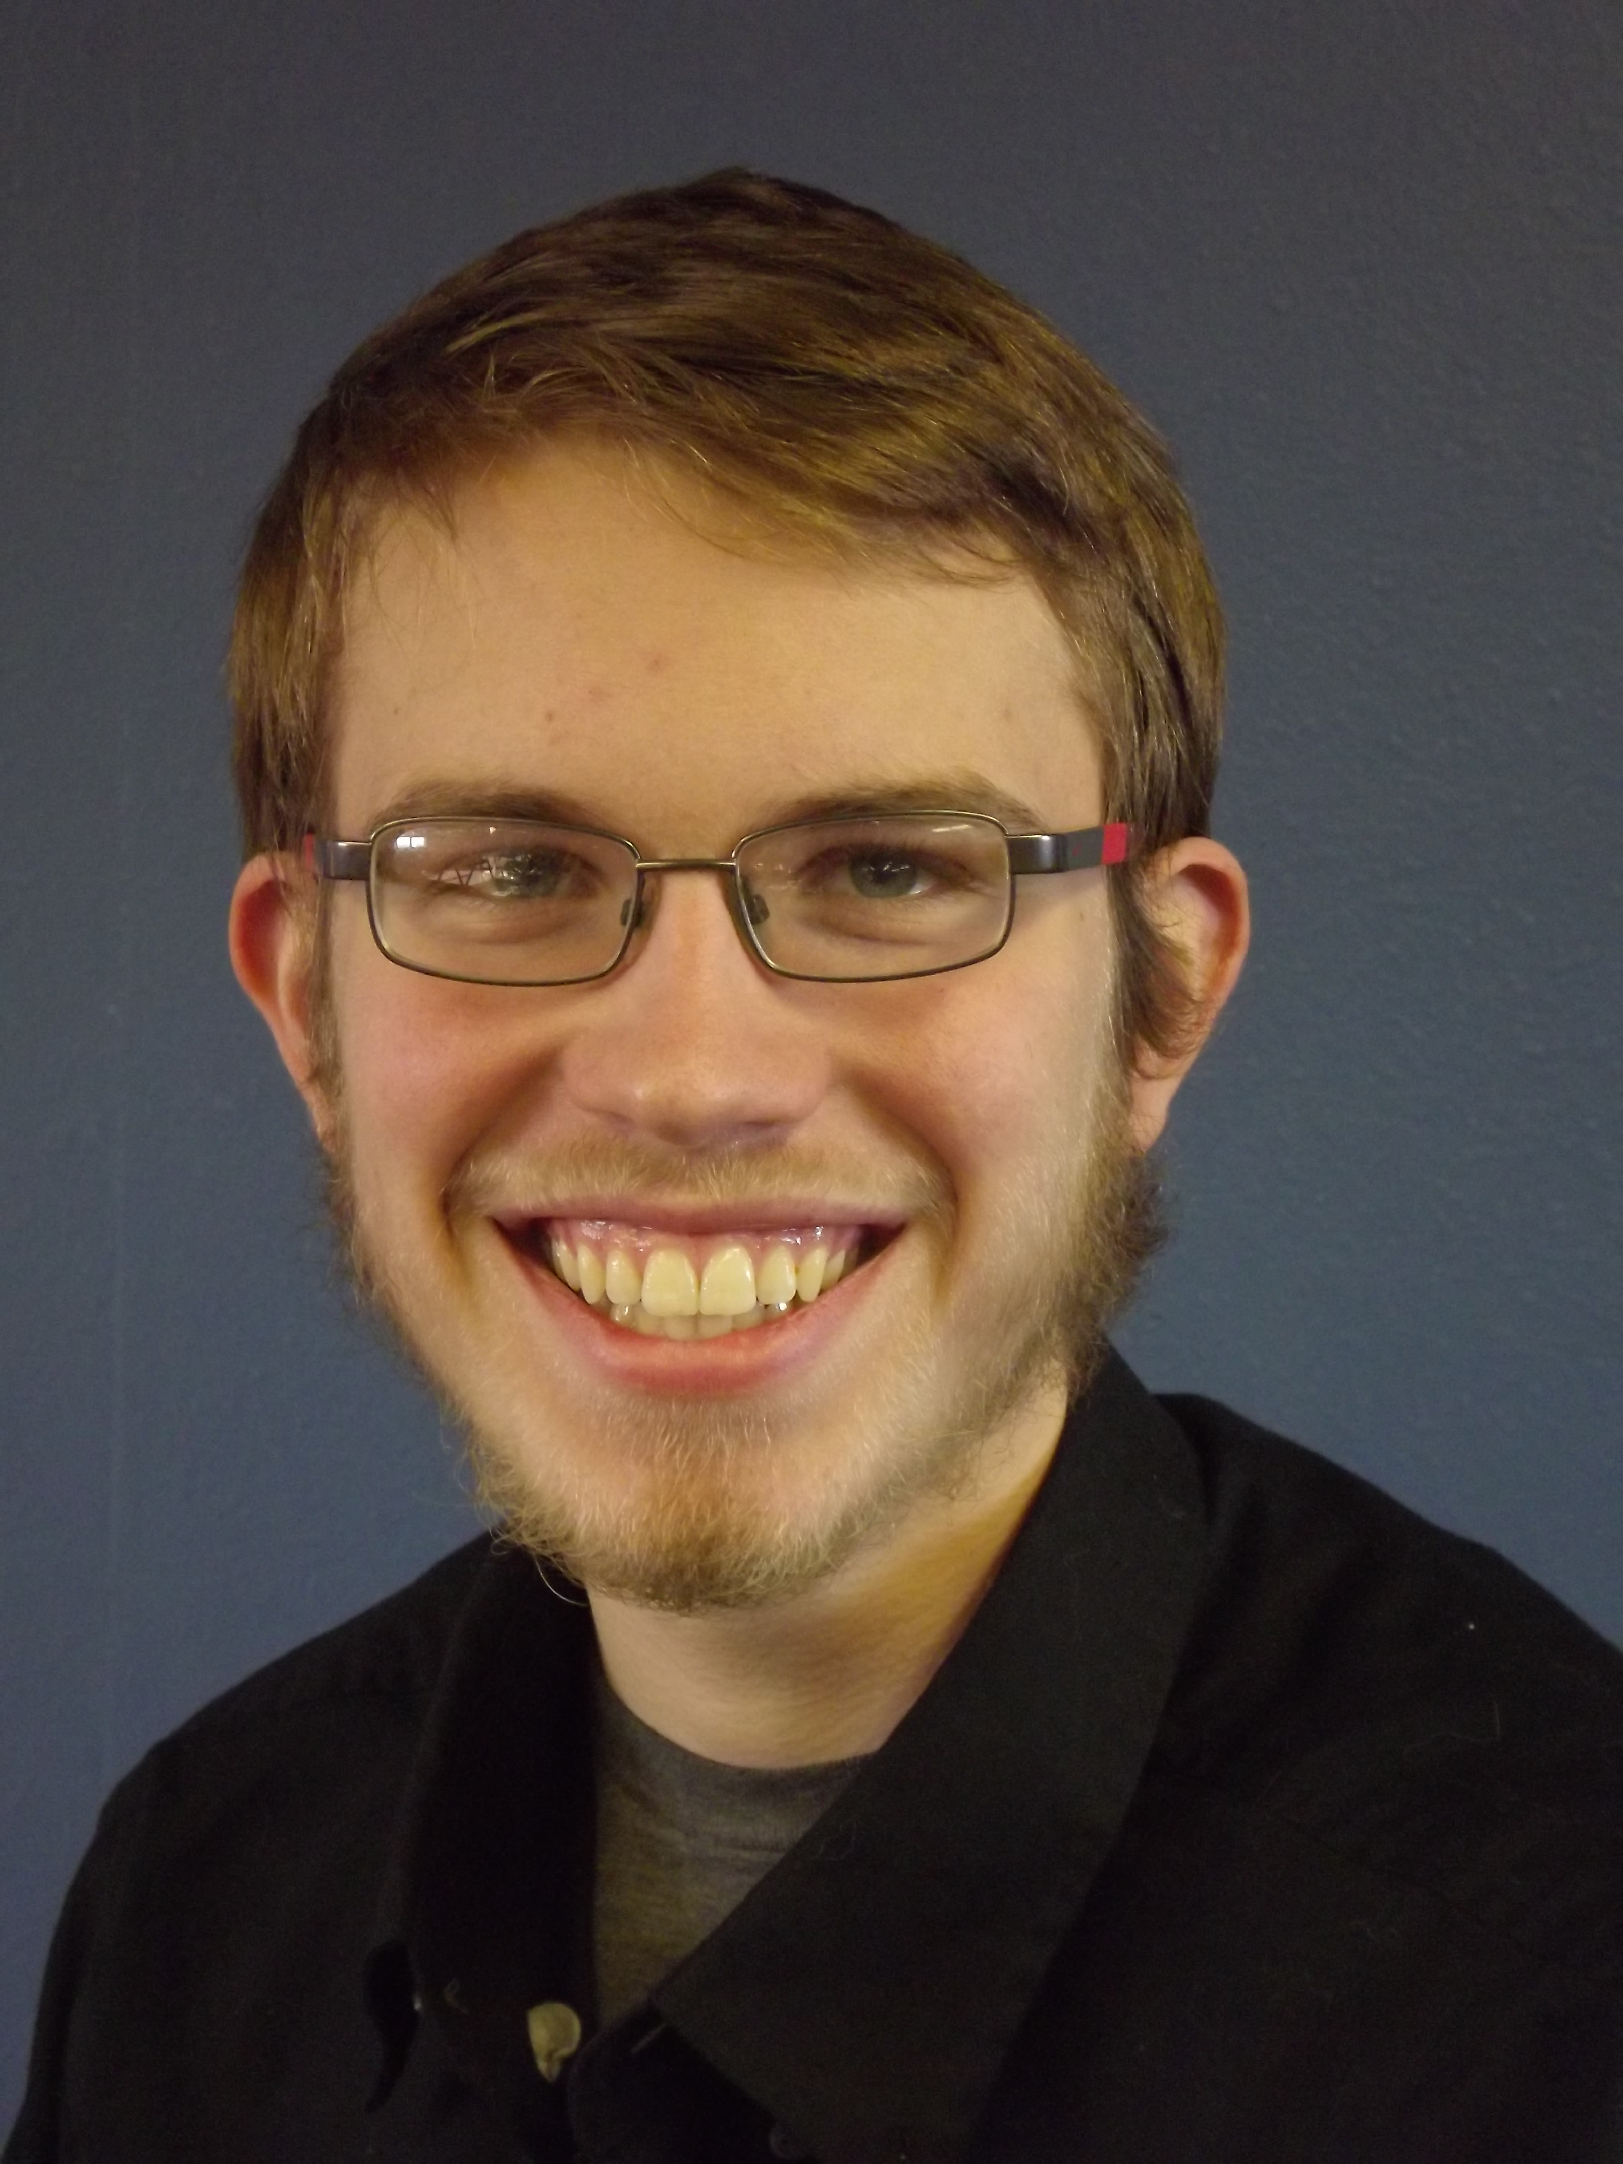
Meet the Team
Samuel Rettig
Software Engineer
Multimedia Framework Researcher
Vibhu Dhavala
Software Engineer
Multimedia Framework Researcher
Cristofer Espinoza
Electrical Engineer
Applications Researcher
Caleb Kitzelman
Electrical Engineer
Applications and XR Researcher
Jake Roskopf
Electrical Engineer
Applications and XR Researcher
Andrew French
Electrical Engineer
XR Researcher
Notes:
Page fades in, red pops up. Only this page

Slide 3
Project Statement
Develop a 5G application benefiting agricultural and/or rural communities
CURRENT GOAL: Create an XR application that demonstrates the capabilities of the ARA network.

Slide 4
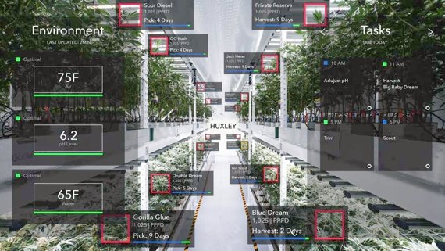
Conceptual Sketch

Slide 5
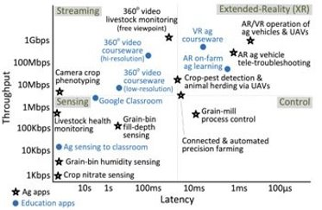
Functional Requirements
Requirements were based around showcasing and testing capabilities of 5G
Must run on the ARA network
Agriculture/Rural Focus
Demonstrates high data throughput
Requires low latency communication

Slide 6
Non-Functional Requirements
UI Elements with intuitive design
Responsiveness of application must feel correct
Must be useful enough to warrant commercialization

Slide 7
Technical Considerations & Constraints
ARA wireless network availability and infrastructure
Current XR technology and Software Design Kits (SDKs)
Durability and longevity

Slide 8
Market Survey
5G offers new opportunities that didn't previously exist, with its low latency and ability to transmit large volumes of real time data.
ARA network allows research into these new opportunities.
Current research into
  Using drones for imaging
  Using IoT sensors
  Automating tractors

Slide 9
Potential Risks & Mitigations
High Priority Risk 1 - Setting up initial connection for hardware and demonstration may be harder than we expected.
Mitigation – We will begin work on this early next fall so that we won't be blindsided by any complications. We'll seek counsel from those familiar with the network.
High Priority Risk 2 - Back-end algorithm development will prove to be difficult, leading to slower than expected delivery of testable software.
Mitigation – Setup software environment during the summer to allow more flexibility during the fall semester.

Slide 10
Resource/Cost Estimate
Most of the things we need to complete our project are either provided through the current ARA project or are open source.
We are in the process of obtaining an XR headset, which will be used in our ARA application and future research.

Slide 11
Project Milestone & Schedule
End of Spring23 – Obtain needed infrastructure.
Start of Fall23 – Research and characterize appropriate open-source software development kits (SDK) for application
November Fall 23 – Create solutions for XR that utilize data analytics and algorithms
End of Fall23 – Refine front-end design and test and verify XR functionality

Slide 12
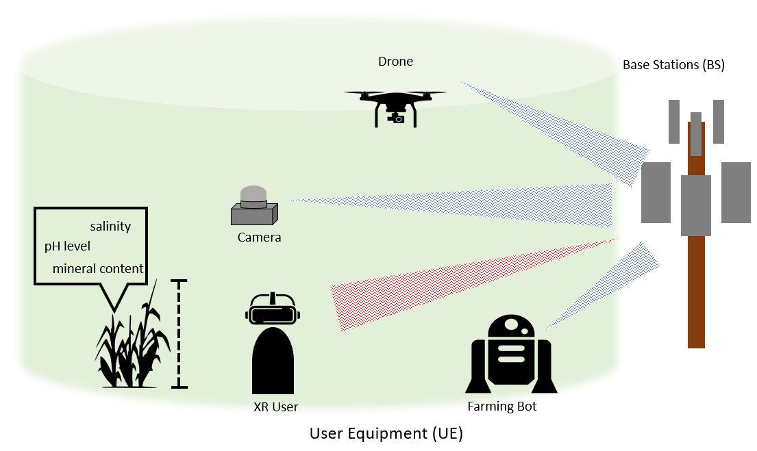
Design
No current functional modules
Prospective ideas using XR in the upcoming semester
  Analyzing images/videos for quantified information or sensor fusion
Creating a framework
Notes:
Main idea, selling the network and how it can be used in ag and rural communities
Want to create a framework to where other XR applications can be built upon

Slide 13
HW – Magic Leap 2 AR/XR Headset
Magic Leap 2
High resolution and refresh rate
70 degrees horizontal field of view
Ability to dim real world to 0.3%
Better specs and reviews for AR experience
Development Software
Unity
C-API
OpenXR now natively supported

Slide 14
SW/Technology Platforms
Native Android application utilizing the headset SDK
OpenXR – API for interfacing between application and XR runtime
Gstreamer – framework for linking transforming data stream types and linking to a pipeline
Monado – XR runtime which provides support for OpenXR and Gstreamer
Agricultural SDKs
  Azure FarmBeats (Data hub for farms)
    Info like Farm Health, Sensor data collection, Soil moisture map, and Insight building AI/ML models

Slide 15
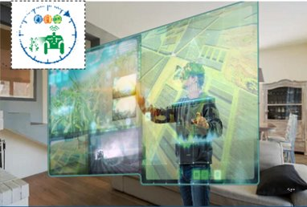
Test Plan
Unit Testing:
  Jitter
  Latency
  Throughput
  Interface Testing:
    Usability
    Displays
    Delay
System Testing:
  Networking(ARA)
  XR Application (Our Team)
Notes:
Unit Testing
Jitter-Difference of Latency
Latency-Delay of data transmission
Throughput-Amount of data
We are not trying to make a high throughput network, but create an application that utilizes the high throughput capabilities of the ARA netowork
Interface
Usability: ability to access data through application, ability to navigate interface, etc
Displays: Data placement, readability, field of view
System Testing:
Identifying issues in each component before putting together and makring sure they function when combined

Slide 16
Project Status
Task | Jan. | Feb. | Mar. | Apr. | May
Develop understanding of mobile networks, architecture and 5G technology
Research issues within rural and ag communities and potential 5G applications
Define an application/device that we want to focus on that will help rural and ag communities
Create a XR headset proposal with research for HoloLens, MagicLeap and Meta for approval
Research into SDKs for XR headsets

Slide 17
Moving Forward
Task | May | June | July | Aug. | Sept. | Oct. | Nov. | Dec.
Order XR headset
Research applicable SDKs available
Perform XR headset setup and configuration
Create solutions for data analytics or automation algorithms
Front-end development and testing

Slide 18
Q&A

